Slide 1

ParC-Net: Position Aware Circular Convolution with Merits from ConvNets and Transformer
2022年11月10日
孔祥旻
Haokui Zhang, Wenze Hu, Xiaoyu Wang. ParC-Net: Position Aware Circular Convolution with Merits from ConvNets and Transformer. ECCV (26) 2022: 613-630S.

Slide 2
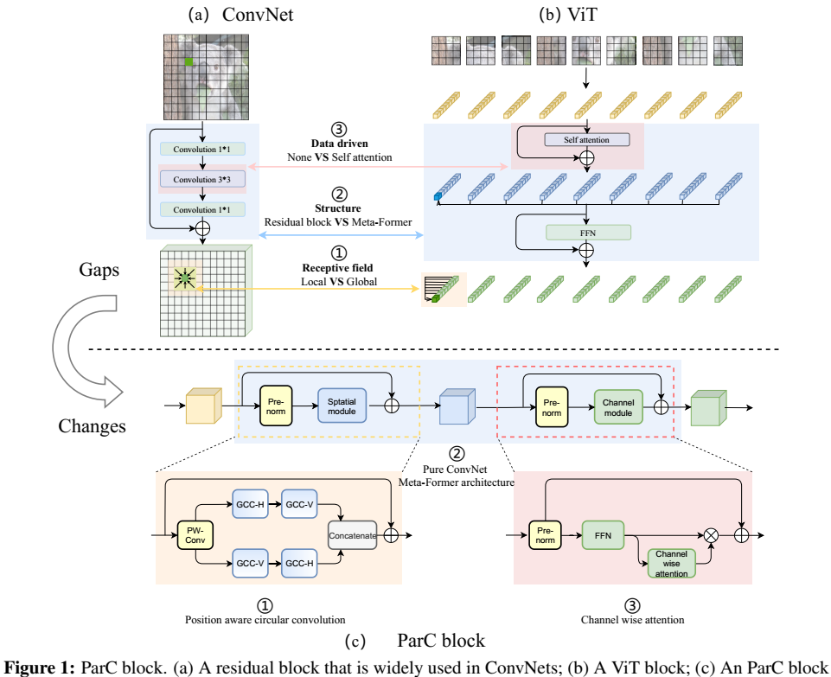
全局特征
Meta-Former
自注意力
Meta Former
ConvNeXt

Slide 3
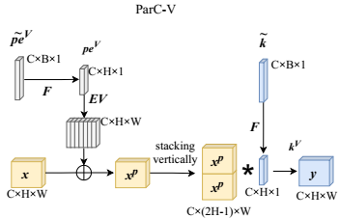
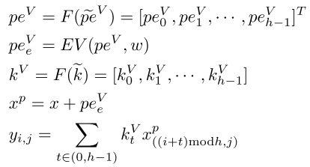
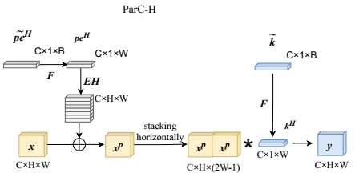
特征提取部分

Slide 4
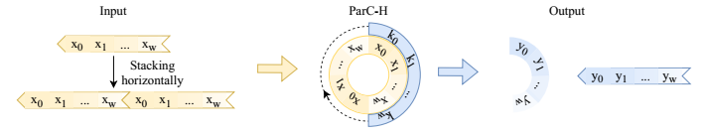
特征提取部分
Figure 3 illustrates the computational process in the case that the input is an one dimensional vector. From Figure 3, we can see that ParC-H perform convolutions along a circle generated by connecting the start and the end of the input.

Slide 5
ParC block
全局特征
Meta-Former
自注意力

Slide 6
模型示意

Slide 7
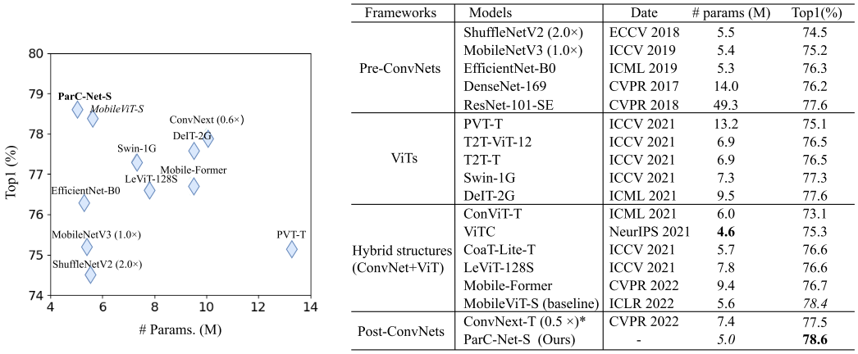
部分结果

Slide 8
感 谢 聆 听

Slide 9
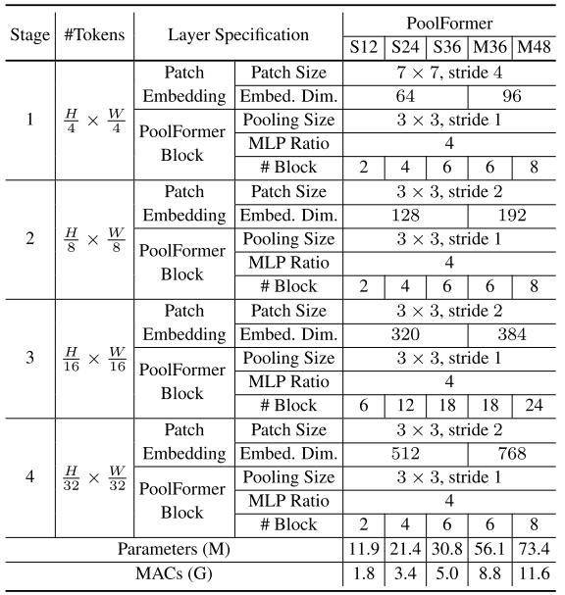
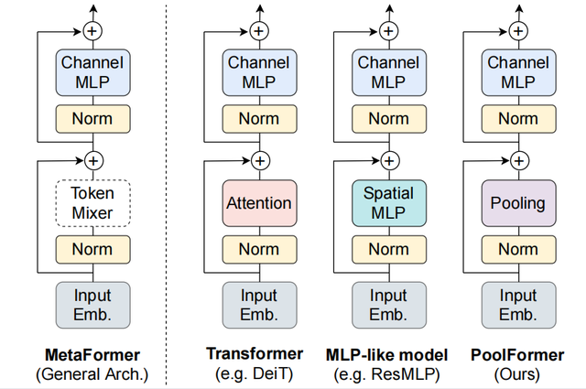
BACK
Meta Former
Weihao Yu, Mi Luo, Pan Zhou, Chenyang Si, Yichen Zhou, Xinchao Wang, Jiashi Feng, and Shuicheng Yan. Metaformer is actually what you need for vision. CVPR 2022: 10809-10819.

Slide 10
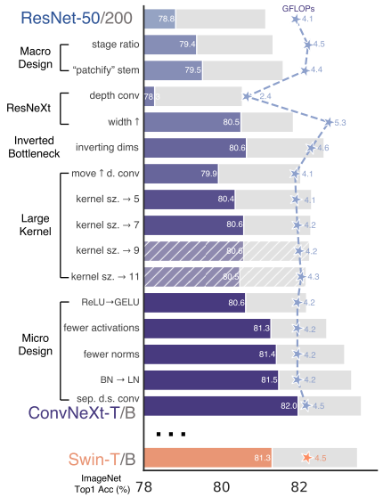
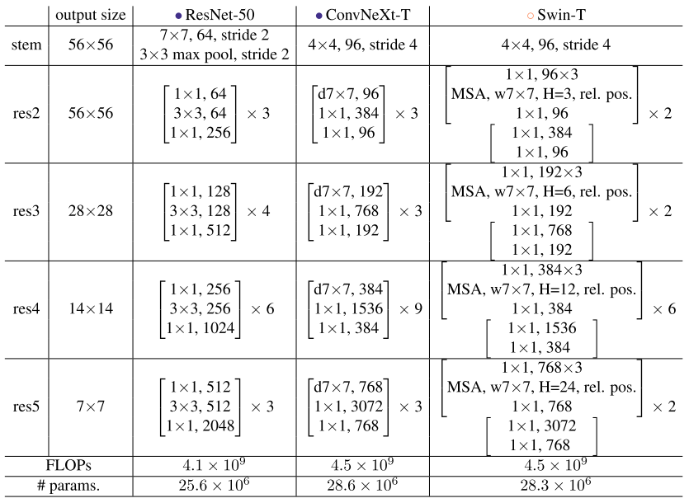
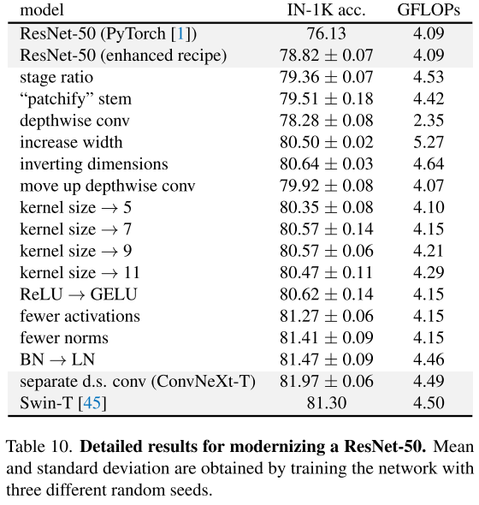
BACK
ConvNeXt
Zhuang Liu, Hanzi Mao, Chao-Yuan Wu, Christoph Feichtenhofer, Trevor Darrell, Saining Xie. A ConvNet for the 2020s. CVPR 2022: 11966-11976

